Slide 1
Overview of Python
Unit 1

Slide 2
About Python
Python was developed by Guido van Rossum in the late eighties and early nineties at the National Research Institute for Mathematics and Computer Science in the Netherlands.
Python is derived from many other languages, including ABC, Modula-3, C, C++, Algol-68, SmallTalk, and Unix shell and other scripting languages.
He named this language after a popular comedy show called 'Monty Python's Flying Circus' (and not after Python-the snake).

Slide 3
About Python
Python is a general-purpose, high-level programming language that was designed emphasize code readability, developer productivity and program portability.
Supports a multitude of programming paradigms.
  OOP, functional, procedural, logic, structured, etc.
It is available for Windows, Linux, Mac OS, and many other operating systems.
Very comprehensive standard library includes numeric modules, crypto services, OS interfaces, networking modules, GUI support, development tools, etc.

Slide 4
Python 2 vs Python 3
Versions of Python are generally available – Python 2.x and Python 3.x.
Python 3.x is not backwards compatible with Python 2.x, which means that the code written in Python 2.x might not work if you have Python 3 installed.

Slide 5
Python Features
Python is a great programming language for beginners. Because it was designed with code readability in mind, it is an excellent choice for newcomers in the world of programming. Here is a list of its major advantages over other programming languages:
less application development time – Python code is usually one-third to one-fifth the size of equivalent C++ or Java code.
code readability – Python code is easy to read, which means you spend less time interpreting it and more time making essential changes.
cost – Python is completely free to use and distribute. You can even download the entire Python system’s source code for free.

Slide 6
Python Features
easy to learn – because of its simplicity and frequent usage of English keywords in the code, Python has become one of the most popular languages for teaching introductory computer science courses.
wide user base – Python is used in a number of successful products. For example, most of YouTube’s core functionality is written in Python and Google uses Python in its search system.
Portable − Python can run on a wide variety of hardware platforms and has the same interface on all platforms.
high salary – Python programmers have one of the highest average salaries in the US.

Slide 7
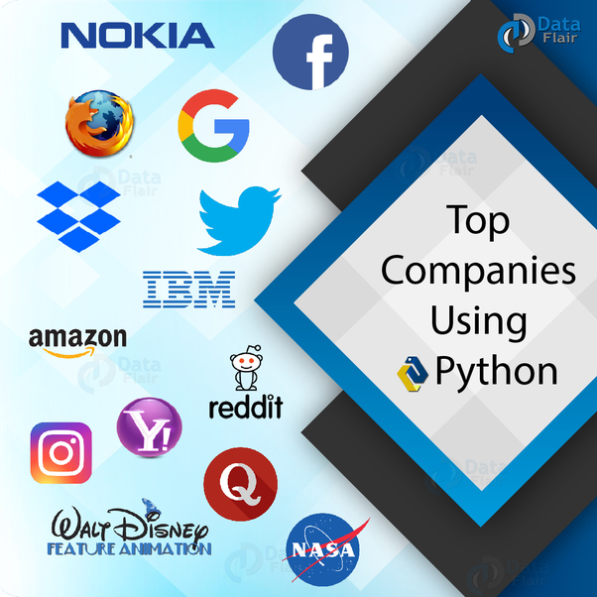
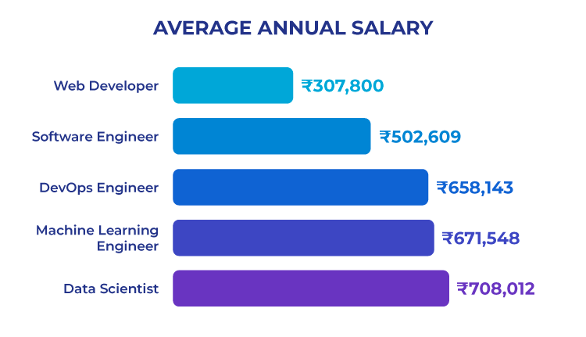

Slide 8
Application development
  Web development
  Machine learning
  Data Analysis
  Scripting
  Game development
  Business application
  Embedded application
  Desktop GUI

Slide 9
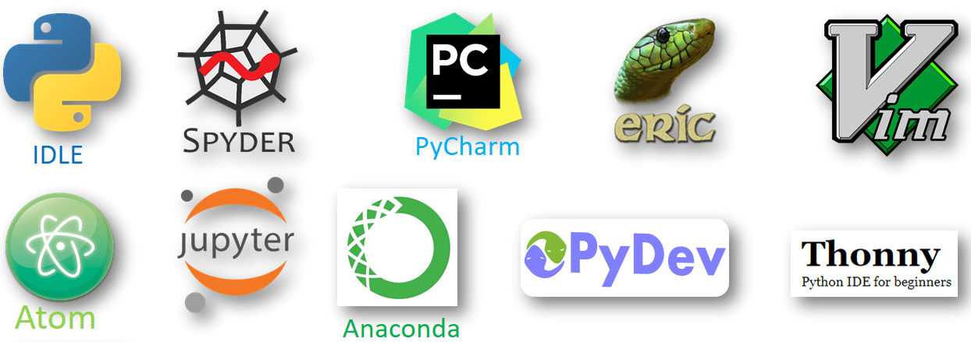
Various Python IDEs

Slide 10
Interpreter
  The standard implementation of Python is interpreted.
  The interpreter translates Python code into bytecode, and this bytecode is executed by the Python VM (similar to Java).
  Two modes: normal and interactive.
  Normal mode: entire .py files are provided to the interpreter.
  Interactive mode: read-eval-print loop (REPL) executes statements piecewise.

Slide 11
Getting started with Python
  Comments
  Variables
  Data types
  Operators
  Decision Making
  Looping
  Functions

Slide 12
Comments
  Types of Comments in Python
  There are two types of comments in Python
  Single line comment
  Multiple line comment
  In python we use # special character to start the comment.
  #Python code to print hello
  print(“hello”)
  Multi-line comment:
  To have a multi-line comment in Python, we use triple single quotes at the beginning and at the end of the comment, as shown below. Mostly it is used as docstring.
  ‘ ’ ’
  This is
  Multiline
  Comment
    ‘ ‘ ‘

Slide 13
Variables and Types
Python is completely object oriented, and not "statically typed". You do not need to declare variables before using them, or declare their type. Every variable in Python is an object.
Variable name – Identifiers
There are few rules that you have to follow while naming the variables in Python.
The name of the variable must always start with either a letter or an underscore (_). For example: _str, str, num, _num are all valid name for the variables.
The name of the variable cannot start with a number. For example: 9num is not a valid variable name.
The name of the variable cannot have special characters such as %, $, # etc, they can only have alphanumeric characters and underscore (A to Z, a to z, 0-9 or _ ).
Variable name is case sensitive in Python which means num and NUM are two different variables in python.

Slide 14
Jupyter Notebook
Jupyter Notebooks are a powerful way to write and iterate on your Python code for data analysis.
Jupyter Notebook is built off of IPython and the Kernel runs the computations and communicates with the Jupyter Notebook front-end interface.
Jupyter Notebook is an open-source web application that allows you to create and share documents that contain live code, equations, visualizations and narrative text.
It is used for data cleaning and transformation, numerical simulation, statistical modeling, data visualization, machine learning, and much more.

